Slide 1

r/Wallstreetbets
Social Media Analytics
By: Ali Sayyed, Siddhant Chauhan, Ram Kapistalam, Brett Nesfeder, Dawson Cook & Mervyn Giritharan
Notes:
Ali

Slide 2
TABLE OF CONTENTS
01
02
03
04
05
06
Methodology
Project Background
Visualizations
Outcomes
Future
Conclusions
Notes:
Ali

Slide 3


Background
Reddit is a prime source of data for performing analysis
Rogue traders from r/WallStreetBets decided to take revenge on Wall Street hedge funds
Rode GME to the moon.
Wall Street and traditional day traders took a big blow
GME stock increased by over 1100%
Notes:
Mervyn
Reddit is a social news and discussion website where people get together, comment on various topics and vote on content submitted by others. This makes Reddit a prime source of data for performing sentiment analysis.
In January of 2020, a group of ‘rogue traders’ from the subreddit channel by the name of WallStreetBets set out on a mission of revenge against Wall Street hedge funds and decided to send the GameStop stock (GME) to the moon.
They were extremely successful in their efforts, increasing the GME stock over 1100%. They got their revenge and made a pretty penny.

Slide 4
Project Goal
Understand and calculate the sentiment of users towards the comments in the r/WallStreetBets subreddit regarding GME during January 2021.
To create a network using Gephi based on posts and sentiment to get a better visual understanding.
To analyze the most upvoted posts and important users to gather insight on how they affect the other users and the community. This data may be analyzed by companies such as RobinHood on a regular basis to prevent future stock closures and be prepared.
Notes:
Mervyn

Slide 5
Game Plan
Scraping Data
Sentiment Analysis
Visualize
Created Scraper
Explored best model for our data
Network Creation Using Gephi
Notes:
Sidd

Slide 6
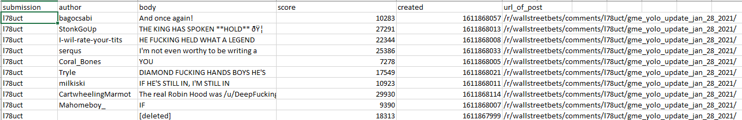
Scraping Data
We built a Reddit scraper to scrape r/WallStreetBets and retrieve the features that we were interested in running our analysis i.e.
Notes:
Sidd
submission - the ID of the user who generated the original post
Author - the ID of the user comments on the post
Body - content of what the author commented
Score - number of upvotes
Created - unique id
Url_of_post - The url to the original post

Slide 7
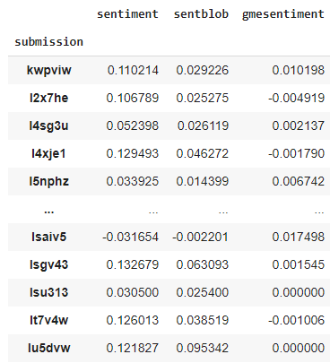
Sentiment Generation for Comments
Three types of sentiment creation methods:
VADER sentiment analysis
TextBlob
VADER on words near ‘GME’
Notes:
Ram

Slide 8
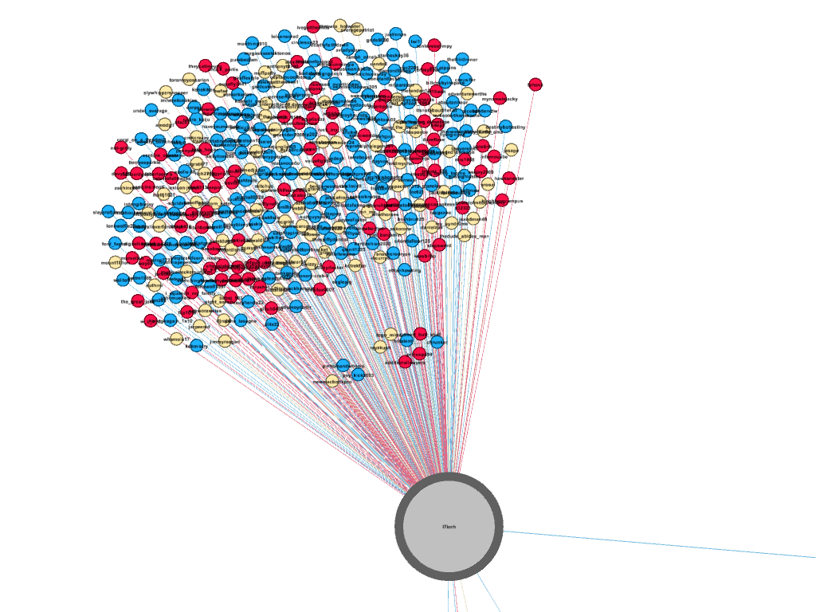
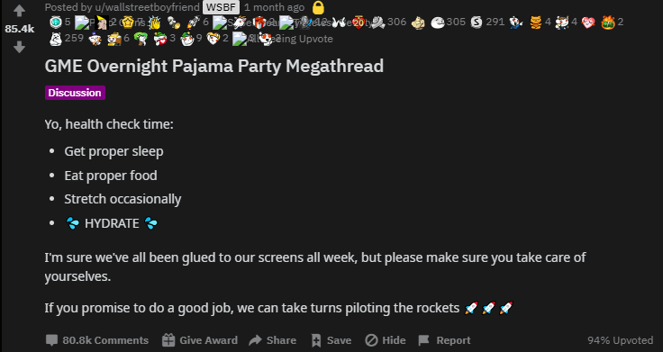
Positive Sentiment - Popular Posts
Notes:
Ram
https://www.reddit.com/r/wallstreetbets/comments/l7iorh/gme_overnight_pajama_party_megathread/

Slide 9
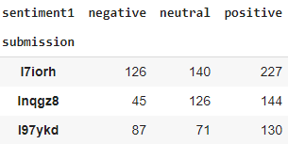



Example Comments from Positive Posts
Notes:
Ram

Slide 10
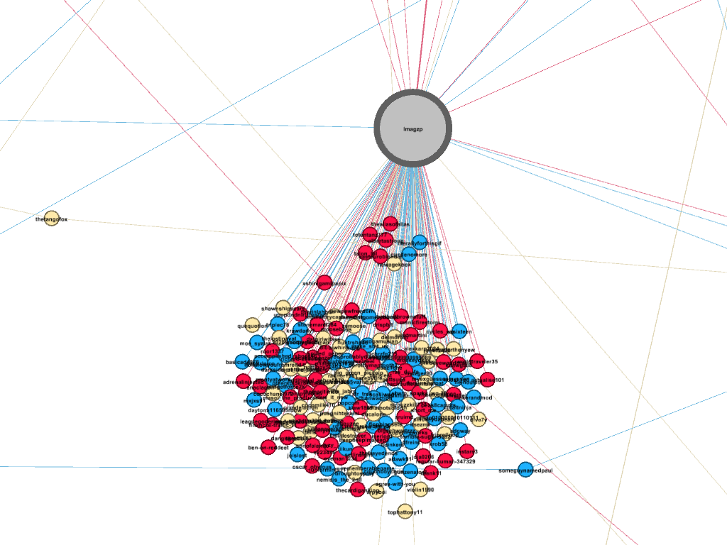
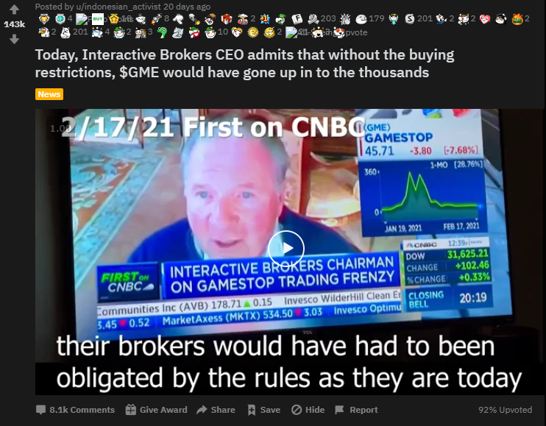
Negative Sentiment - Popular Posts
Notes:
Brett
https://www.reddit.com/r/wallstreetbets/comments/lmagzp/today_interactive_brokers_ceo_admits_that_without/

Slide 11
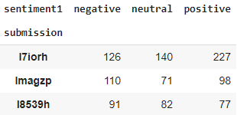


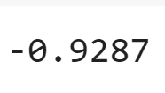
Example Comments from Negative Posts
Notes:
Brett

Slide 12
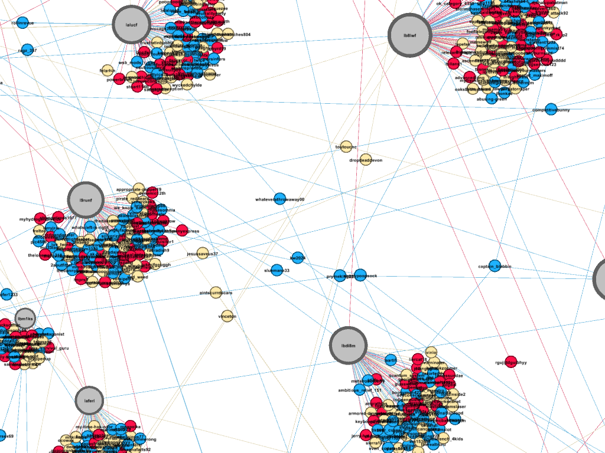
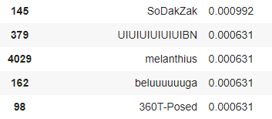
Influential Users across Posts
Top Degree Centrality (Fraction of nodes connected to)
Notes:
Ali

Slide 13
Business Outcomes
Financial Services
Individual Investors
Fintech Companies should assess what types of posts and comments are influential both positively and negatively. Helpful from a PR perspective to address controversy early.
When deciding what to invest in, might be more useful to monitor sentiment and network metrics versus only looking at upvotes.
Notes:
Dawson

Slide 14
Future Work and Limitations
Realtime tracking of reddit user engagement on certain stocks
Utilizing AI to pick on r/WSB trends
Investment Notifications
Robo Advising Partnerships
They have serious pull in actual stock market
More data means better insights
Hedge Funds
Scraping More Data
Notes:
Dawson
Hedge funds have power to limit investors using financial service companies (robin hood)

Slide 15
Questions?
Notes:
Dawson

